Slide 1
General License Course Chapter 4.5
Active Components

Slide 2
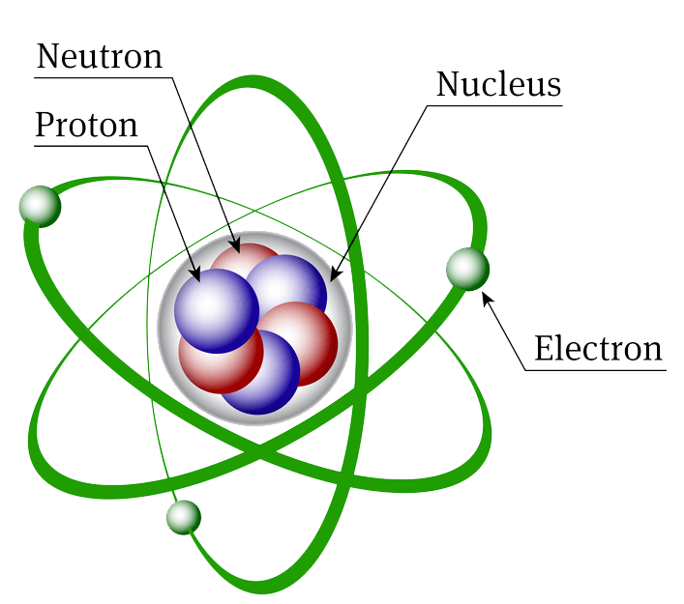
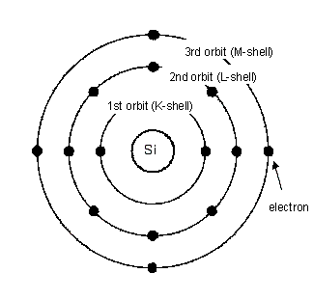
Atomic Structure
The number of Protons = the number of Electrons

Slide 3
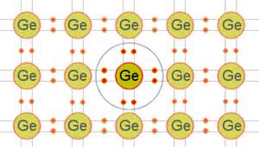
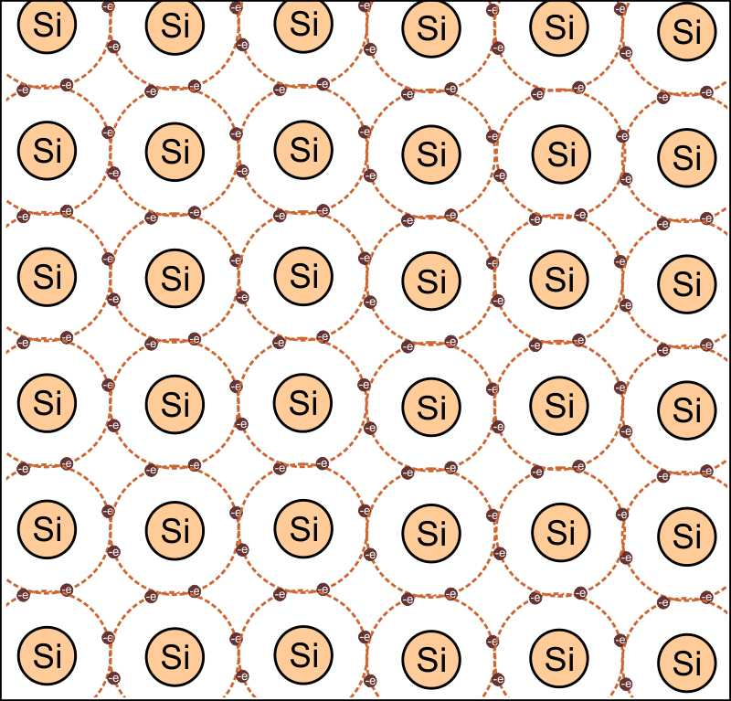
Atomic Lattice
Germanium and Silicon are used in semiconductor devices.
Each has 4 electrons in their outermost valence electron shell
Covalent Bonding

Slide 4
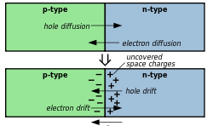
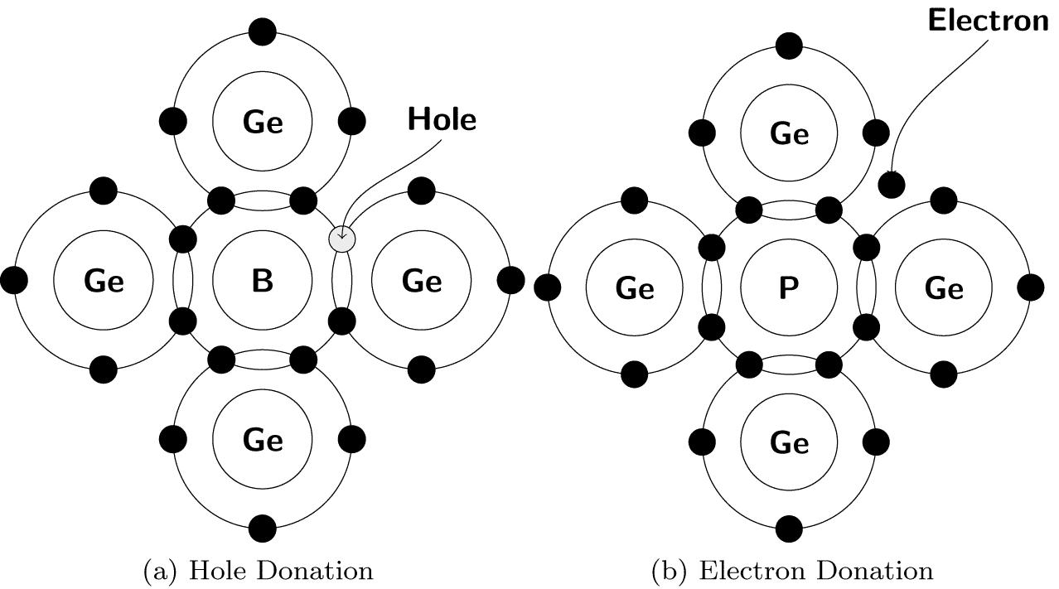
Semiconductor
Semiconductor material is created by “doping” crystalline (non-conducting) lattices with impurities to allow them to “semi-conduct”
Near the PN junction, electrons diffuse across to combine with holes, creating a "depletion region"

Slide 5
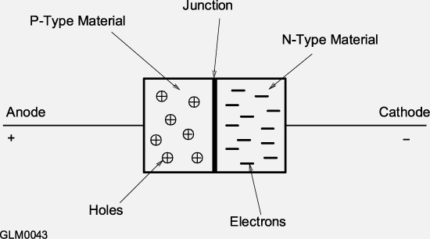
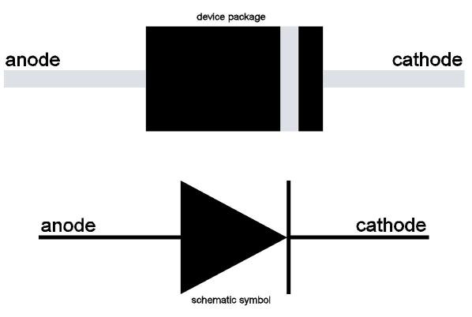
Semiconductor Components
Diodes & Rectifiers
Junction diode - PN semiconductor junction blocks flow of current in one direction
Current flows when (+) voltage is applied to the P-type material and (-) voltage to the N-type material - forward bias
Diode forward voltage drop (or junction threshold voltage, to overcome the depletion region) : germanium 0.3 V - silicon 0.7 V

Slide 6
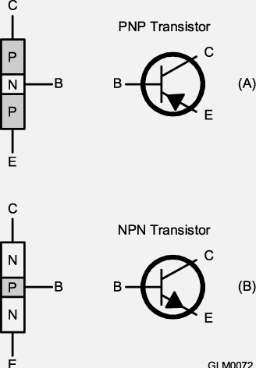
Bipolar Transistors
Bipolar junction transistors have 3 electrodes:
Collector (C)
Base (B)
Emitter (E)
Emitter-Collector current flow is controlled by the much smaller current flow between base and emitter

Slide 7
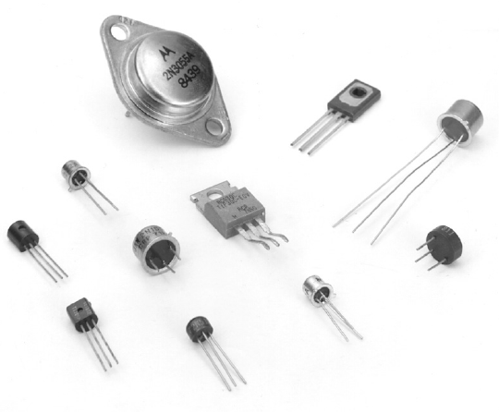
Bipolar Transistors
Very little base-emitter current is required for emitter-collector current to flow
Control of the above larger current by a smaller current is current gain or beta (β)

Slide 8
Bipolar Transistors
Transistors can be used as as switches for voltage and current
Saturation – when further increases in input result in no output change (logic HI or 1)
Cutoff – when the input signal reduces output current to zero (logic LO or Ø)
Saturation & cutoff regions can represent digital ON/OFF or 1/Ø values - Stable Operating Points for logic circuit use

Slide 9
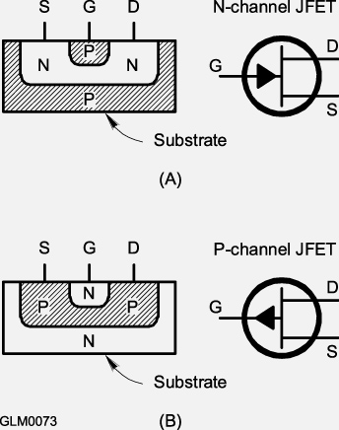
Field Effect Transistor (FET)
The FET has 3 electrodes; Drain (D), Source (S) and Gate (G)
Current flow is controlled by the voltage between gate and source.
Junction FET or JFET
Metal-Oxide-Semiconductor FETs (MOSFETs) insulate the gate from the channel with a thin layer of oxide
(Static Sensitive!)

Slide 10
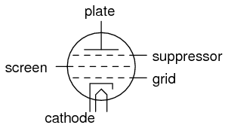
Vacuum Tubes
Tube terminology:
Filament or heater – heats the cathode to allow it emit electrons
Cathode – source of electrons (negative bias)
Control grid – regulates electron travel between the cathode and plate
Screen grid – reduces grid-to-plate capacitance
Suppressor grid – prevents electrons from traveling between the plate and control/screen grids
Plate – collects electrons
heater

Slide 11
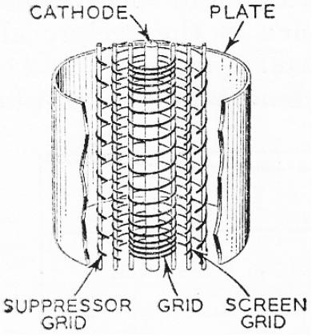
(and heater)
Pentode Cross-Section

Slide 12
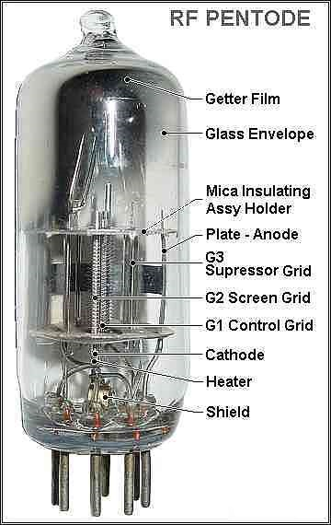
Vacuum Tubes
All amplifying tubes have at least 3 electrodes
Compared to transistors, the tube is most like the field effect transistor (FET)
Vacuum tubes sometimes operate at hazardous voltages as high as 2000 to 3000 volts (use CAUTION!)

Slide 13
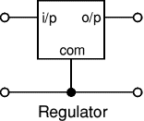
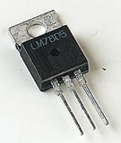
Analog Integrated Circuits (ICs)
Analog ICs or “chips”:
Can have an output value anywhere between zero volts and the supply voltage
Used for amplification, filtering, measurement, and power control
A linear voltage regulator is used to maintain a power supply output at a constant voltage over a wide range of currents (Analog)
Operational amplifiers (op amps) are used for dc and audio circuits (Analog)

Slide 14
Digital Integrated Circuits (ICs)
Digital ICs operate with discrete values of voltage and current which can easily represent the binary numbers system (logic) values 0 and 1 (lo, hi)
Digital electronic circuits operate with only two stable states of operation, ON or OFF (see above)
Digital circuits can perform computations or control functions
CMOS (complementary-symmetry metal-oxide semiconductor) technology is popular because of its high speed and low power consumption (vs. TTL) - often Static Sensitive!

Slide 15
Digital Logic Basics
The basic building blocks of digital circuits are called gates
Inversion (changing a 1 to a 0 and vice versa)
OR and AND functions
Inverted versions are NOR and NAND
Truth tables explain the functions implemented by the gates

Slide 16
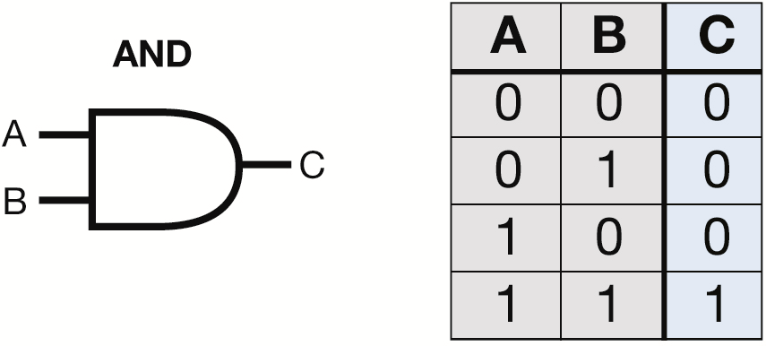
Digital Logic Basics
For a two input AND gate, the output is high
only when both inputs are high

Slide 17
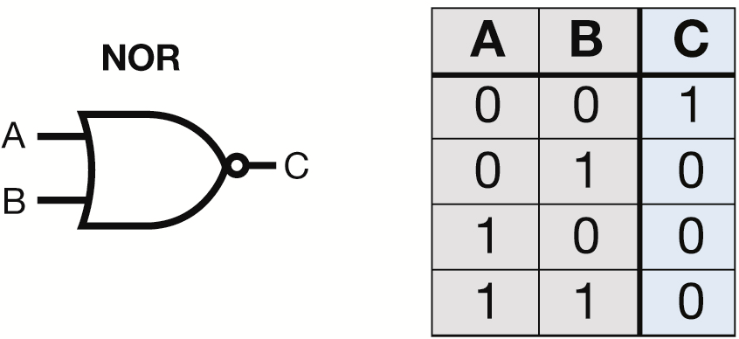
Digital Logic Basics
For a two input NOR gate, the output is low
when either or both inputs are high.

Slide 18
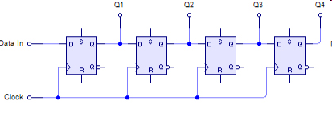
Digital Logic Basics
Flip-flop – has 2 stable output states (Hi, Lo) - when pulsed by the clock output O changes to whatever logic level is present at input D
Sequential logic – built on flip-flops feeding other flip-flo`ps (used in counters)
Examples : A 3-bit counter (one with 3 flip-flops) can count 2³ = 8 different states - a 4-bit counter (one with 4 flip-flops, shown below) can count 2⁴ = 16 different states
Shift register – a clocked array of circuits that passes data in steps along the array
2³ 2² 2¹ 2⁰

Slide 19
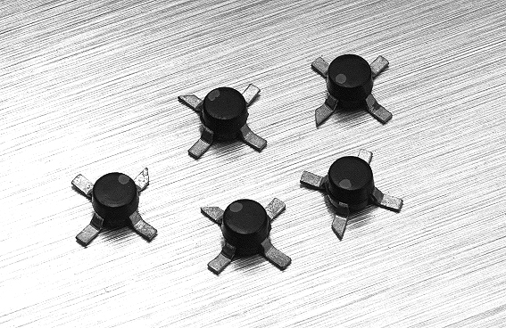
RF Integrated Circuits
RF ICs are designed for functions commonly used for radio frequencies
Low-level high-gain amplifiers
Mixers
Modulators and demodulators
Filters
MMIC (monolithic microwave integrated circuit) - designed to work through microwave frequencies

Slide 20
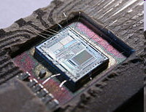
Microprocessors & Components
A microprocessor (AKA microcontroller) is a computer on a single Integrated Circuit
Capable of performing billions of instructions per second using combinations of digital logic gates
Has parallel and serial input-output ports, counters and timers
Most are built from CMOS logic components
A microprocessor can replace complex digital circuitry

Slide 21
Microprocessor Components
Memory:
Volatile memory loses the data stored when power is removed
Nonvolatile memory retains data permanently even when power is off
Random-access memory (RAM) can be read or written to in any order
Read-only memory (ROM) stores data permanently and can’t be changed

Slide 22
Microprocessor Components
Interfaces:
Serial interface transfers one bit of data in each operation
Parallel interface transfers multiple bits of data in each operation
RS-232 serial interface has been replaced by USB (universal serial bus) serial interface
Modern computers don’t have RS-232 ports; you may need to use a USB to RS-232 converter to interface with your transceiver

Slide 23
Microprocessor Components
Visual Interfaces:
Indicator – device that presents ON/OFF information (LED)
Display – device capable of presenting text or graphics in visual form
An LED is a special diode that produces light when it is forward biased
LEDs are available in several different colors, including white
LEDs are replacing incandescent light bulbs because they last longer, react faster, and consume less power.

Slide 24
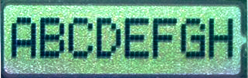
Microprocessor Components
Liquid crystal display (LCD) – created by sandwiching liquid crystal material between transparent glass panels
When voltage is applied to the electrodes on the front panel, the liquid crystals twist and turn the segment from light to dark-colored
LCDs require ambient or back lighting since the liquid crystal layer does not generate light. They offer high contrast in situations with high ambient lighting

Slide 25
Take Quiz 1

Slide 26
G6A03 - What is the approximate forward threshold voltage of a germanium diode?
A. 0.1 volt
B. 0.3 volts
C. 0.7 volts
D. 1.0 volts

Slide 27
G6A03 - What is the approximate forward threshold voltage of a germanium diode?
A. 0.1 volt
B. 0.3 volts
C. 0.7 volts
D. 1.0 volts

Slide 28
G6A05 - What is the approximate forward threshold voltage of a silicon junction diode?
A. 0.1 volt
B. 0.3 volts
C. 0.7 volts
D. 1.0 volts

Slide 29
G6A05 - What is the approximate forward threshold voltage of a silicon junction diode?
A. 0.1 volt
B. 0.3 volts
C. 0.7 volts
D. 1.0 volts

Slide 30
G6A07 - What are the operating points for a bipolar transistor used as a switch?
A. Saturation and cutoff
B. The active region (between cutoff and saturation)
C. Peak and valley current points
D. Enhancement and depletion modes

Slide 31
G6A07 - What are the operating points for a bipolar transistor used as a switch?
A. Saturation and cutoff
B. The active region (between cutoff and saturation)
C. Peak and valley current points
D. Enhancement and depletion modes

Slide 32
G6A09 - Which of the following describes MOSFET construction?
A. The gate is formed by a back-biased junction
B. The gate is separated from the channel by a thin insulating layer
C. The source is separated from the drain by a thin insulating layer
D. The source is formed by depositing metal on silicon

Slide 33
G6A09 - Which of the following describes MOSFET construction?
A. The gate is formed by a back-biased junction
B. The gate is separated from the channel by a thin insulating layer
C. The source is separated from the drain by a thin insulating layer
D. The source is formed by depositing metal on silicon

Slide 34
G6A10 - Which element of a vacuum tube regulates the flow of electrons between cathode and plate?
A. Control grid
B. Suppressor grid
C. Screen grid
D. Trigger electrode

Slide 35
G6A10 - Which element of a vacuum tube regulates the flow of electrons between cathode and plate?
A. Control grid
B. Suppressor grid
C. Screen grid
D. Trigger electrode

Slide 36
G6A12 - What is the primary purpose of a screen grid in a vacuum tube?
A. To reduce grid-to-plate capacitance
B. To increase efficiency
C. To increase the control grid resistance
D. To decrease plate resistance

Slide 37
G6A12 - What is the primary purpose of a screen grid in a vacuum tube?
A. To reduce grid-to-plate capacitance
B. To increase efficiency
C. To increase the control grid resistance
D. To decrease plate resistance

Slide 38
G6B02 - What is meant by the term MMIC?
A. Multi-Mode Integrated Circuit
B. Monolithic Microwave Integrated Circuit
C. Metal Monolayer Integrated Circuit
D. Mode Modulated Integrated Circuit

Slide 39
G6B02 - What is meant by the term MMIC?
A. Multi-Mode Integrated Circuit
B. Monolithic Microwave Integrated Circuit
C. Metal Monolayer Integrated Circuit
D. Mode Modulated Integrated Circuit

Slide 40
G6B03 - Which of the following is an advantage of CMOS integrated circuits compared to TTL integrated circuits?
A. Low power consumption
B. High power handling capability
C. Better suited for RF amplification
D. Better suited for power supply regulation

Slide 41
G6B03 - Which of the following is an advantage of CMOS integrated circuits compared to TTL integrated circuits?
A. Low power consumption
B. High power handling capability
C. Better suited for RF amplification
D. Better suited for power supply regulation

Slide 42
G6B06 - What kind of device is an integrated circuit operational amplifier?
A. Digital
B. MMIC
C. Programmable Logic
D. Analog

Slide 43
G6B06 - What kind of device is an integrated circuit operational amplifier?
A. Digital
B. MMIC
C. Programmable Logic
D. Analog

Slide 44
G7B03 - Which of the following describes the function of a two-input AND gate?
A. Output is high when either or both inputs are low
B. Output is high only when both inputs are high
C. Output is low when either or both inputs are high
D. Output is low only when both inputs are high

Slide 45
G7B03 - Which of the following describes the function of a two-input AND gate?
A. Output is high when either or both inputs are low
B. Output is high only when both inputs are high
C. Output is low when either or both inputs are high
D. Output is low only when both inputs are high

Slide 46
G7B05 - How many states does a 3-bit binary counter have?
A. 3
B. 6
C. 8
D. 16

Slide 47
G7B05 - How many states does a 3-bit binary counter have?
A. 3
B. 6
C. 8
D. 16

Slide 48
G7B06 - What is a shift register?
A. A clocked array of circuits that passes data in steps along the array
B. An array of operational amplifiers used for tri-state arithmetic operations
C. A digital mixer
D. An analog mixer

Slide 49
G7B06 - What is a shift register?
A. A clocked array of circuits that passes data in steps along the array
B. An array of operational amplifiers used for tri-state arithmetic operations
C. A digital mixer
D. An analog mixer

Slide 50
G6B08 - How is an LED biased when emitting light?
A. In the tunnel-effect region
B. At the Zener voltage
C. Reverse biased
D. Forward biased

Slide 51
G6B08 - How is an LED biased when emitting light?
A. In the tunnel-effect region
B. At the Zener voltage
C. Reverse biased
D. Forward biased

Slide 52
G6B09 (A)
How does a liquid crystal display compare to an LED display?
A. Higher contrast in high ambient lighting
B. Wider dynamic range
C. Higher Power consumption
D. Shorter lifetime

Slide 53
G6B09 (A)
How does a liquid crystal display compare to an LED display?
A. Higher contrast in high ambient lighting
B. Wider dynamic range
C. Higher Power consumption
D. Shorter lifetime

Slide 54
General License Course Chapter 4.6
Practical Circuits

Slide 55
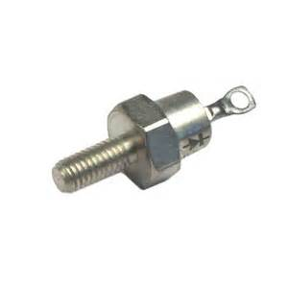
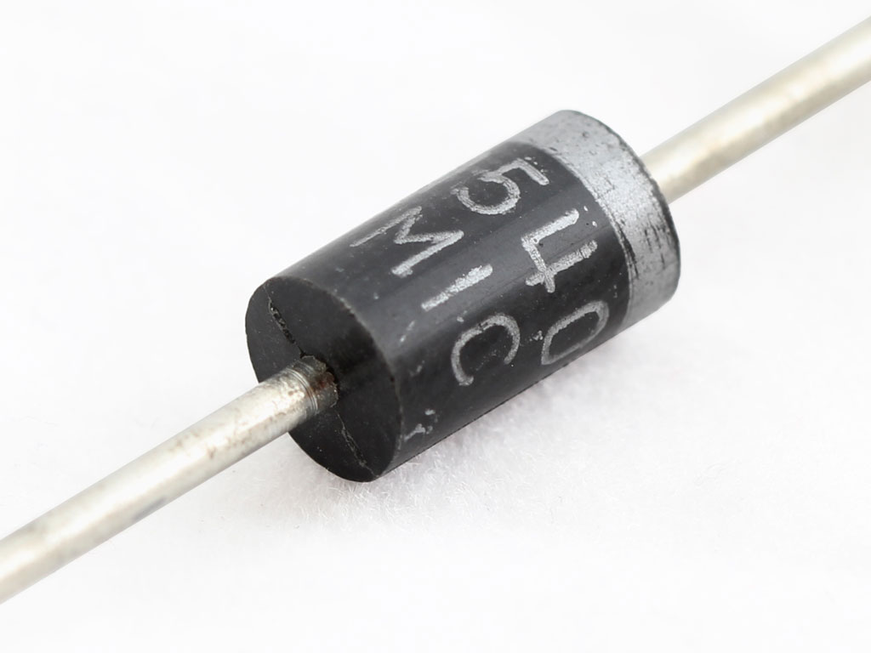
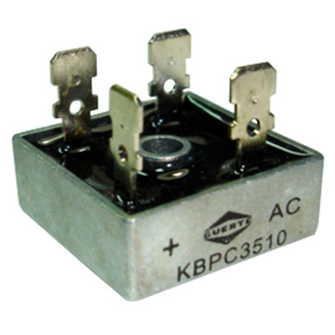
Rectifiers
A rectifier diode is an electronic device that converts alternating current (AC, which periodically reverses direction) to direct current (DC, which flows in only one direction). The process is known as rectification.

Slide 56
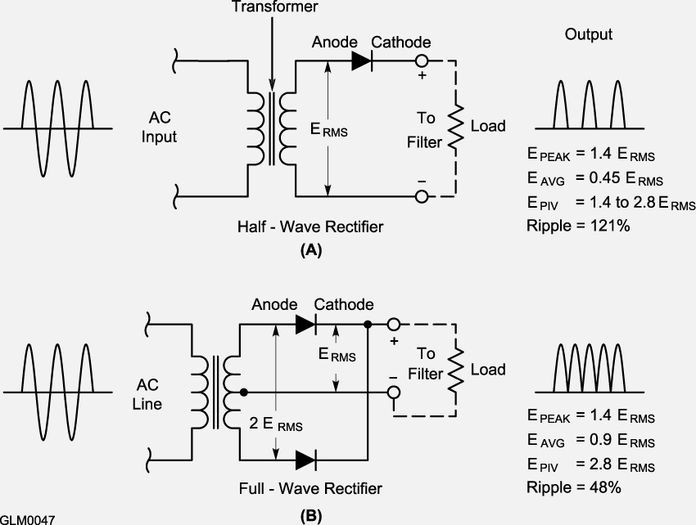
Rectifiers
Half-wave rectifier - allows current to flow in one-half of the input ac waveform (180°) from the transformer, as shown in “A” Advantage: only one diode is required
Full-wave center-trapped rectifier - two half-wave rectifiers operating on alternating half cycles, as shown in “B”, using the transformer center tap for the current’s return path

Slide 57
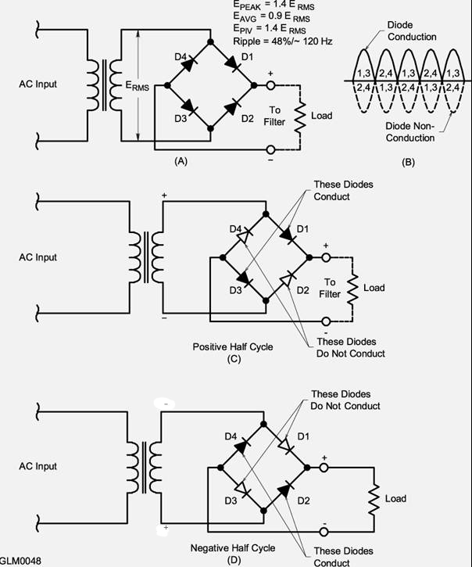
Rectifiers
Full Wave Rectifier Circuits
Advantage – output is produced during entire 360° of the ac cycle
Output is a series of pulses at twice the frequency of the input voltage
Full-wave bridge rectifier – uses a pair of diodes on alternating ac cycle halves

Slide 58
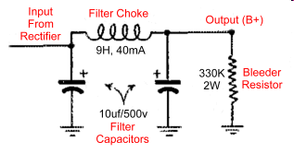
Filter Circuits
A Rectifier's pulsed output is often unusable as DC
Filter networks – made up of capacitors and inductors
an inductor to filter (resist) current variations
a capacitor to filter (resist) voltage variations

Slide 59
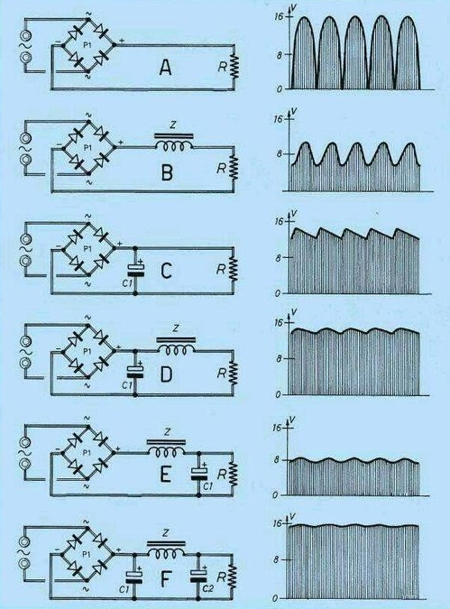
Power Supply Filtering

Slide 60
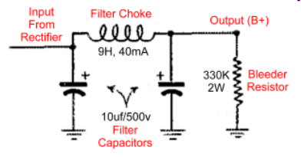
Power Supplies
Power supply safety:
Fuses (transformer primary side) are used to protect against short circuits or excessive current
Bleeder resistors discharge energy stored in the PS filter capacitors when the supply is turned off
Working on power supplies – wait for the bleeder resistor to discharge energy, even if the PS is unplugged

Slide 61
Power Supplies
Switching or Switchmode supplies:
Transistors switch current pulses at a high frequency (20 kHz or more*) through a transformer then capacitors and inductors filter the voltage
High frequency operation allows small, lightweight components (transformers, capacitors, inductors) to be used
Linear supplies are very heavy due to their large, iron-core power transformer and large filter inductors/capacitors
*RFI supression must be included in the design.

Slide 62
Batteries
Large marine or RV storage batteries are often used as emergency backup power supplies
Liquid-electrolyte or gel-electrolyte batteries are rated at 12 V but should be maintained at 13.8 V
Lead-acid batteries are useful until their output drops to 10.5 V
Discharging batteries past their minimum voltage will reduce the life of the battery

Slide 63
Batteries
Never attempt to recharge a carbon-zinc, alkaline, or silver-nickel type battery (the chemical reaction cannot be reversed)
Battery self-discharge gradually reduces stored energy over time
Slow this discharge by storing in a cool, dry place
Freezing will damage batteries with liquid or gel electrolytes

Slide 64
Rechargeable Batteries
Different types of rechargable batteries require different charging methods
NiCad, NMH, Li-Ion
Use the proper type of charger to maximize the life and usefulness of the battery
NiCds (or Nicads) – designed to have low internal resistance to supply high discharge current

Slide 65
Alternative Power
Solar Power – photovoltaic conversion of sunlight directly to electricity
Solar cells are a special type of diode
The forward voltage created as the electrons cross the P-N junction is approximately 0.5 V dc (open circuit voltage) when fully illuminated
Individual solar cells can be connected in series to create higher voltages (24 cells to create 12 V) AND in parallel to provide more current. SERIES-PARALLEL
Wind generators use DC generators to charge batteries; an inverter is used to convert to AC, if needed

Slide 66
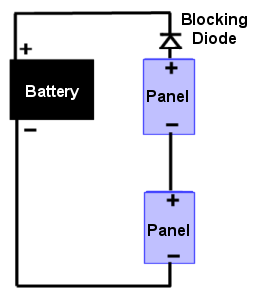
Energy Storage
Disadvantage: Wind and solar power require a substantial energy storage system; No wind or sun means no power
Excess power needs to be stored during peak periods of generation (batteries are the most common method) – a Charge Controller must be included to prevent damage to the batteries
Diodes (in series) prevent the batteries from discharging back through the solar panels
Charge Controller

Slide 67
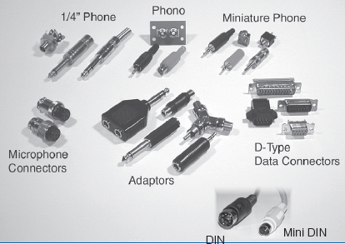
Audio Connectors
Consumer electronics and Amateur Radio share many of the same connectors

Slide 68
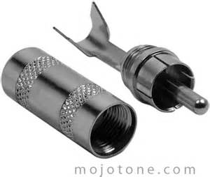
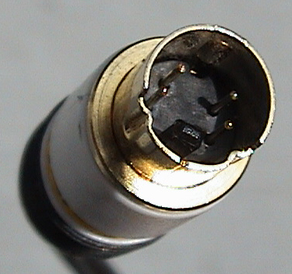
Audio Connectors
Phono plugs (also called RCA connectors) are commonly used for low frequency (audio) and DC signals
DIN or mini-DIN connectors are keyed and have up to 9 pins
and are used for audio or control signals for radio equipment

Slide 69
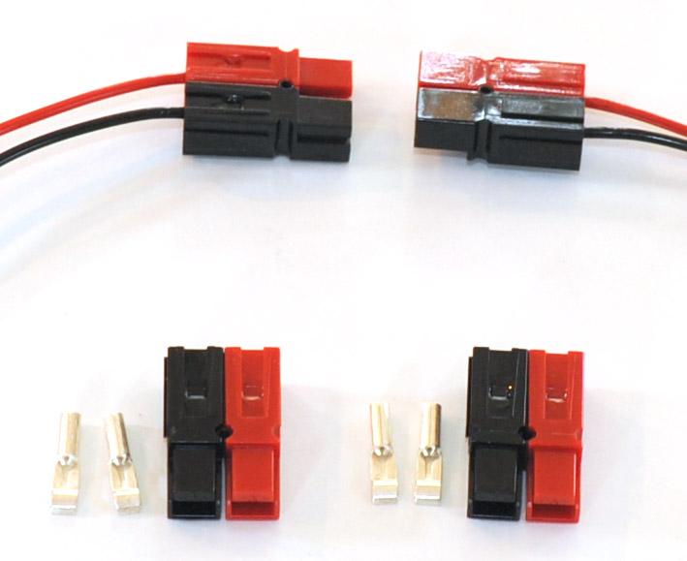
Power Connectors
Anderson Powerpole connectors have become the standard for connecting radios and associated devices to 12 vdc supplies

Slide 70
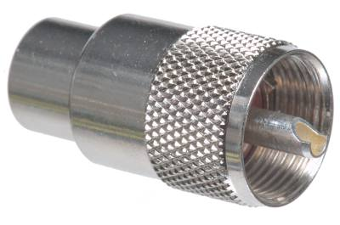
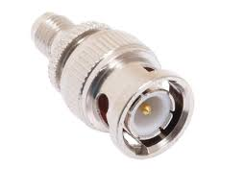
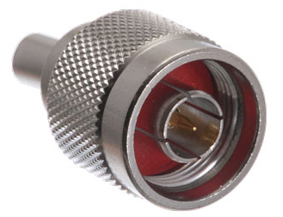
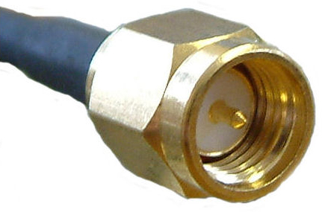
RF Connectors
Special RF feed line connectors:
“PL-259” (aka UHF) connectors can be used up to 150 MHz
“BNC” connectors can be used up to 4 GHz
“N” connectors are moisture resistant and used up to 10 GHz
“SMA”* connectors are small threaded connectors designed for miniature coaxial cable and are rated up to several GHz
* You can’t spell SMALL without SMA!

Slide 71
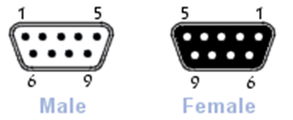
Data Connectors
Digital data is exchanged between the computers and radios:
D-type connectors are used for RS-232 (COM ports) and parallel ports
D-type 9-pin connector is referred to as DB-9 or DE-9 (commonly used for serial ports)
25-pin D-type connector used for parallel ports
USB ports are standard for modern computers

Slide 72
Take Quiz 2

Slide 73
G7A01 - What is the function of a power supply bleeder resistor?
A. It acts as a fuse for excess voltage
B. It discharges the filter capacitors when power is removed
C. It removes shock hazards from the induction coils
D. It eliminates ground loop current

Slide 74
G7A01 - What is the function of a power supply bleeder resistor?
A. It acts as a fuse for excess voltage
B. It discharges the filter capacitors when power is removed
C. It removes shock hazards from the induction coils
D. It eliminates ground loop current

Slide 75
G7A02 - Which of the following components are used in a power supply filter network?
A. Diodes
B. Transformers and transducers
C. Capacitors and inductors
D. All these choices are correct

Slide 76
G7A02 - Which of the following components are used in a power supply filter network?
A. Diodes
B. Transformers and transducers
C. Capacitors and inductors
D. All these choices are correct

Slide 77
G7A03 - Which type of rectifier circuit uses two diodes and a center-tapped transformer?
A. Full-wave
B. Full-wave bridge
C. Half-wave
D. Synchronous

Slide 78
G7A03 - Which type of rectifier circuit uses two diodes and a center-tapped transformer?
A. Full-wave
B. Full-wave bridge
C. Half-wave
D. Synchronous

Slide 79
G7A04 - What is characteristic of a half-wave rectifier in a power supply?
A. Only one diode is required
B. The ripple frequency is twice that of a full-wave rectifier
C. More current can be drawn from the half-wave rectifier
D. The output voltage is two times the peak input voltage

Slide 80
G7A04 - What is characteristic of a half-wave rectifier in a power supply?
A. Only one diode is required
B. The ripple frequency is twice that of a full-wave rectifier
C. More current can be drawn from the half-wave rectifier
D. The output voltage is two times the peak input voltage

Slide 81
G7A05 - What portion of the AC cycle is converted to DC by a half-wave rectifier?
A. 90 degrees
B. 180 degrees
C. 270 degrees
D. 360 degrees

Slide 82
G7A05 - What portion of the AC cycle is converted to DC by a half-wave rectifier?
A. 90 degrees
B. 180 degrees
C. 270 degrees
D. 360 degrees

Slide 83
G7A06 - What portion of the AC cycle is converted to DC by a full-wave rectifier?
A. 90 degrees
B. 180 degrees
C. 270 degrees
D. 360 degrees

Slide 84
G7A06 - What portion of the AC cycle is converted to DC by a full-wave rectifier?
A. 90 degrees
B. 180 degrees
C. 270 degrees
D. 360 degrees

Slide 85
G7A07 - What is the output waveform of an unfiltered full-wave rectifier connected to a resistive load?
A. A series of DC pulses at twice the frequency of the AC input
B. A series of DC pulses at the same frequency as the AC input
C. A sine wave at half the frequency of the AC input
D. A steady DC voltage

Slide 86
G7A07 - What is the output waveform of an unfiltered full-wave rectifier connected to a resistive load?
A. A series of DC pulses at twice the frequency of the AC input
B. A series of DC pulses at the same frequency as the AC input
C. A sine wave at half the frequency of the AC input
D. A steady DC voltage

Slide 87
G7A08 - Which of the following is characteristic of a switchmode power supply as compared to a linear power supply?
A. Faster switching time makes higher output voltage possible
B. Fewer circuit components are required
C. High-frequency operation allows the use of smaller components
D. Inherently more stable

Slide 88
G7A08 - Which of the following is characteristic of a switchmode power supply as compared to a linear power supply?
A. Faster switching time makes higher output voltage possible
B. Fewer circuit components are required
C. High-frequency operation allows the use of smaller components
D. Inherently more stable

Slide 89
G4E08 - In what configuration are the individual cells in a solar panel connected together?
A. Series-parallel
B. Shunt
C. Bypass
D. Full-wave bridge

Slide 90
G4E08 - In what configuration are the individual cells in a solar panel connected together?
A. Series-parallel
B. Shunt
C. Bypass
D. Full-wave bridge

Slide 91
G4E09 - What is the approximate open-circuit voltage from a fully illuminated silicon photovoltaic cell?
A. 0.02 VDC
B. 0.5 VDC
C. 0.2 VDC
D. 1.38 VDC

Slide 92
G4E09 - What is the approximate open-circuit voltage from a fully illuminated silicon photovoltaic cell?
A. 0.02 VDC
B. 0.5 VDC
C. 0.2 VDC
D. 1.38 VDC

Slide 93
G4E10 - Why should a series diode be connected between a solar panel and a storage battery that is being charged by the panel?
A. To prevent overload by regulating the charging voltage
B. To prevent discharge of the battery through the panel during times of low or no illumination
C. To limit the current flowing from the panel to a safe value
D. To prevent damage to the battery due to excessive voltage at high illumination levels

Slide 94
G4E10 - Why should a series diode be connected between a solar panel and a storage battery that is being charged by the panel?
A. To prevent overload by regulating the charging voltage
B. To prevent discharge of the battery through the panel during times of low or no illumination
C. To limit the current flowing from the panel to a safe value
D. To prevent damage to the battery due to excessive voltage at high illumination levels

Slide 95
G4E11 - What precaution should be taken when connecting a solar panel to a lithium iron phosphate battery?
A. Ground the solar panel outer metal framework
B. Ensure the battery is placed terminals-up
C. A series resistor must be in place
D. The solar panel must have a charge controller

Slide 96
G4E11 - What precaution should be taken when connecting a solar panel to a lithium iron phosphate battery?
A. Ground the solar panel outer metal framework
B. Ensure the battery is placed terminals-up
C. A series resistor must be in place
D. The solar panel must have a charge controller

Slide 97
G6A01 - What is the minimum allowable discharge voltage for maximum life of a standard 12-volt lead-acid battery?
A. 6 volts
B. 8.5 volts
C. 10.5 volts
D. 12 volts

Slide 98
G6A01 - What is the minimum allowable discharge voltage for maximum life of a standard 12-volt lead-acid battery?
A. 6 volts
B. 8.5 volts
C. 10.5 volts
D. 12 volts

Slide 99
G6A02 - What is an advantage of batteries with low internal resistance?
A. Long life
B. High discharge current
C. High voltage
D. Rapid recharge

Slide 100
G6A02 - What is an advantage of batteries with low internal resistance?
A. Long life
B. High discharge current
C. High voltage
D. Rapid recharge

Slide 101
G6B04 - What is a typical upper frequency limit for low SWR operation of 50-ohm BNC connectors?
A. 50 MHz
B. 500 MHz
C. 4 GHz
D. 40 GHz

Slide 102
G6B04 - What is a typical upper frequency limit for low SWR operation of 50-ohm BNC connectors?
A. 50 MHz
B. 500 MHz
C. 4 GHz
D. 40 GHz

Slide 103
G6B07 - Which of the following describes a type N connector?
A. A moisture-resistant RF connector useful to 10 GHz
B. A small bayonet connector used for data circuits
C. A low noise figure VHF connector
D. A nickel plated version of the PL-259

Slide 104
G6B07 - Which of the following describes a type N connector?
A. A moisture-resistant RF connector useful to 10 GHz
B. A small bayonet connector used for data circuits
C. A low noise figure VHF connector
D. A nickel plated version of the PL-259

Slide 105
G6B11 - What is an SMA connector?
A. A type-S to type-M adaptor
B. A small threaded connector suitable for signals up to several GHz
C. A connector designed for serial multiple access signals
D. A type of push-on connector intended for high-voltage applications

Slide 106
G6B11 - What is an SMA connector?
A. A type-S to type-M adaptor
B. A small threaded connector suitable for signals up to several GHz
C. A connector designed for serial multiple access signals
D. A type of push-on connector intended for high-voltage applications

Slide 107
G6B12 - Which of these connector types is commonly used for low frequency or dc signal connections to a transceiver?
A. PL-259
B. BNC
C. RCA Phono
D. Type N

Slide 108
G6B12 - Which of these connector types is commonly used for low frequency or dc signal connections to a transceiver?
A. PL-259
B. BNC
C. RCA Phono
D. Type N

Slide 109
General License Course Chapter 4.7
Basic Test Equipment

Slide 110
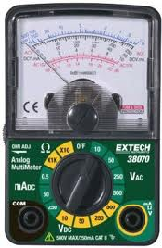
Analog Meters
A Volt-ohm meter (VOM) is the most basic piece of test equipment
Measures – volts, current, resistance
Tests – continuity, diodes, transistors
Analog Meters
Analog meters have a moving needle and calibrated scales on the meter face
Analog meters are useful for finding a maximum or minimum reading, such as when adjusting a tuned circuit

Slide 111
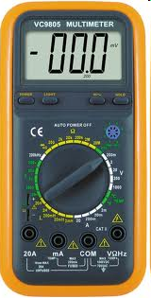
Digital Meters
Digital meters (DMMs) offer significantly greater precision than analog meters
Digital meters often have useful features:
auto-ranging to automatically select the proper display range
peak hold to capture maximum values
When measuring voltage, the meter should have a high input impedance to place the minimum load on the circuit being measured

Slide 112
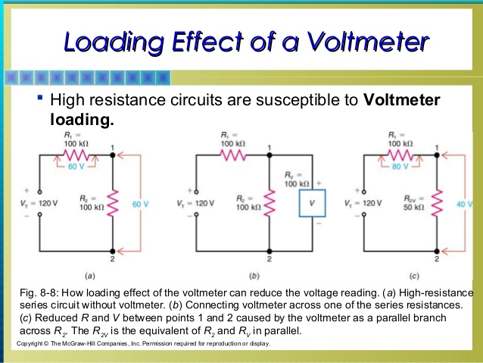

Slide 113
Oscilloscope
The oscilloscope (O-scope) provides a visual display of voltage vs. time
Updated rapidly enough to give a real-time picture of the signal
Fast-changing complex waveforms can be measured
External signals are connected to horizontal and vertical channel amplifier inputs to control the display
Variable gain and update rates are available to display many types of signals.

Slide 114
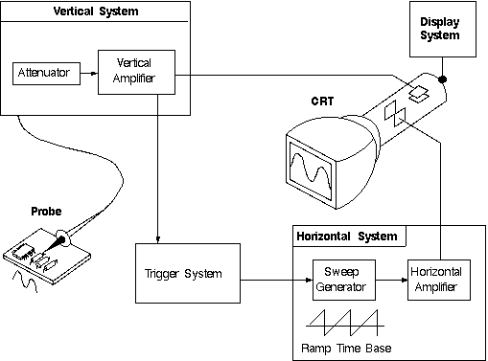
Oscilloscope
An oscilloscope is an item of test equipment that contains horizontal and vertical channel amplifiers

Slide 115
Oscilloscope
C:\Users\ai2n\Videos\General Course - Videos\O-Scope_Time_Base_Demo.wmv

Slide 116
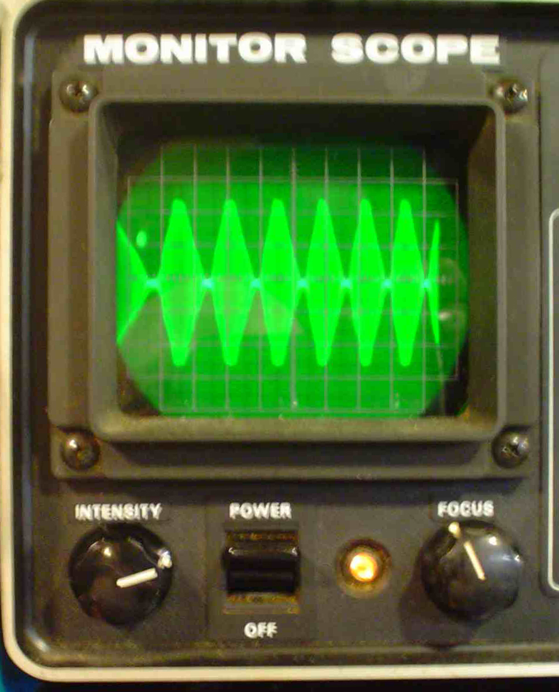
Monitoring Oscilloscope
The transmitter’s attenuated RF output connects to the vertical channel of the oscilloscope to monitor the signal
Monitoring helps adjust CW keying waveforms, mic gain, and speech processing
The scope shows the effects of any adjustments that might cause distortion
A “scope” provides information that numeric meters can’t measure.

Slide 117
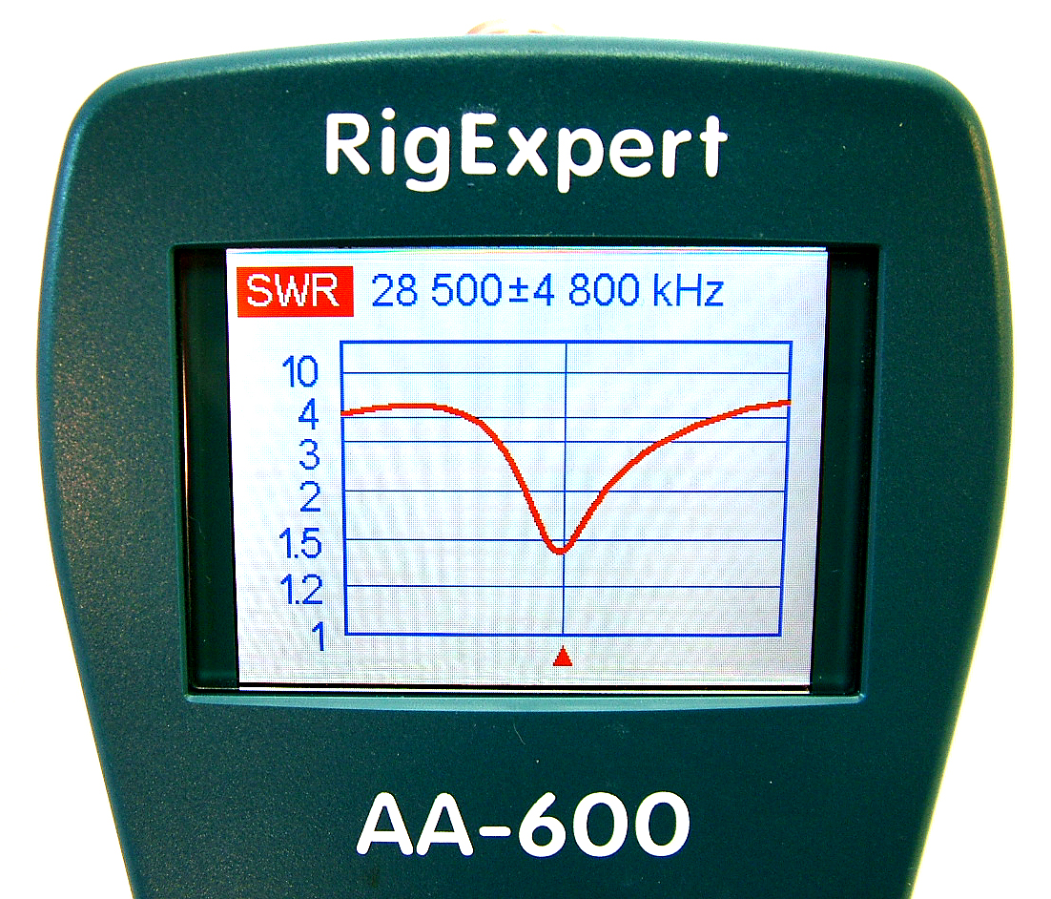
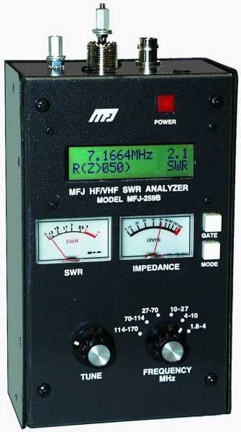
Impedance & Resonance Measurement
An antenna analyzer contains a signal generator, frequency counter, SWR bridge, and impedance meter
Connects to the antenna and feed line to measure Standing Wave Ratio (SWR) using very small signals for measurements
Impedance measurements show resonance
Measures feed line/coax velocity factor, electrical length, and characteristic impedance
Can be negatively affected by strong nearby signals

Slide 118
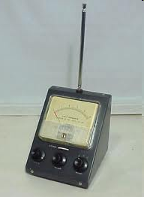
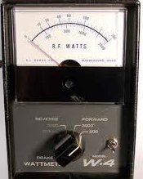
Field Strength & Power Meters
Field strength meters measure the electrical field of transmitted signals
Field strength meters can be used during antenna and transmitter adjustments
Field strength meters can be used to measure antenna radiation patterns
Standing Wave Ratio (SWR) can be determined from forward and reflected power measurements made with a directional wattmeter

Slide 119
Field Strength Meter
C:\Users\ai2n\Videos\General Course - Videos\Field_Strength_Meter_Demo.wmv

Slide 120
Take Quiz 3

Slide 121
G4B01 - What item of test equipment contains horizontal and vertical channel amplifiers?
A. An ohmmeter
B. A signal generator
C. An ammeter
D. An oscilloscope

Slide 122
G4B01 - What item of test equipment contains horizontal and vertical channel amplifiers?
A. An ohmmeter
B. A signal generator
C. An ammeter
D. An oscilloscope

Slide 123
G4B02 - Which of the following is an advantage of an oscilloscope versus a digital voltmeter?
A. An oscilloscope uses less power
B. Complex impedances can be easily measured
C. Greater precision
D. Complex waveforms can be measured

Slide 124
G4B02 - Which of the following is an advantage of an oscilloscope versus a digital voltmeter?
A. An oscilloscope uses less power
B. Complex impedances can be easily measured
C. Greater precision
D. Complex waveforms can be measured

Slide 125
G4B03 - Which of the following is the best instrument to use for checking the keying waveform of a CW transmitter?
A. An oscilloscope
B. A field strength meter
C. A sidetone monitor
D. A wavemeter

Slide 126
G4B03 - Which of the following is the best instrument to use for checking the keying waveform of a CW transmitter?
A. An oscilloscope
B. A field strength meter
C. A sidetone monitor
D. A wavemeter

Slide 127
G4B04 - What signal source is connected to the vertical input of an oscilloscope when checking the RF envelope pattern of a transmitted signal?
A. The local oscillator of the transmitter
B. An external RF oscillator
C. The transmitter balanced mixer output
D. The attenuated RF output of the transmitter

Slide 128
G4B04 - What signal source is connected to the vertical input of an oscilloscope when checking the RF envelope pattern of a transmitted signal?
A. The local oscillator of the transmitter
B. An external RF oscillator
C. The transmitter balanced mixer output
D. The attenuated RF output of the transmitter

Slide 129
G4B05 - Why do voltmeters have high input impedance?
A. It improves the frequency response
B. It allows for higher voltages to be safely measured
C. It improves the resolution of the readings
D. It decreases the loading on circuits being measured

Slide 130
G4B05 - Why do voltmeters have high input impedance?
A. It improves the frequency response
B. It allows for higher voltages to be safely measured
C. It improves the resolution of the readings
D. It decreases the loading on circuits being measured

Slide 131
G4B06 - What is an advantage of a digital multimeter as compared to an analog multimeter?
A. Better for measuring computer circuits
B. Less prone to overload
C. Higher precision
D. Faster response

Slide 132
G4B06 - What is an advantage of a digital multimeter as compared to an analog multimeter?
A. Better for measuring computer circuits
B. Less prone to overload
C. Higher precision
D. Faster response

Slide 133
G4B09 - When is an analog multimeter preferred to a digital multimeter?
A. When testing logic circuits
B. When high precision is desired
C. When measuring the frequency of an oscillator
D. When adjusting circuits for maximum or minimum values

Slide 134
G4B09 - When is an analog multimeter preferred to a digital multimeter?
A. When testing logic circuits
B. When high precision is desired
C. When measuring the frequency of an oscillator
D. When adjusting circuits for maximum or minimum values

Slide 135
G4B10 - Which of the following can be determined with a directional wattmeter?
A. Standing wave ratio
B. Antenna front-to-back ratio
C. RF interference
D. Radio wave propagation

Slide 136
G4B10 - Which of the following can be determined with a directional wattmeter?
A. Standing wave ratio
B. Antenna front-to-back ratio
C. RF interference
D. Radio wave propagation

Slide 137
G4B11 - Which of the following must be connected to an antenna analyzer when it is being used for SWR measurements?
A. Receiver
B. Transmitter
C. Antenna and feed line
D. All these choices are correct

Slide 138
G4B11 - Which of the following must be connected to an antenna analyzer when it is being used for SWR measurements?
A. Receiver
B. Transmitter
C. Antenna and feed line
D. All these choices are correct

Slide 139
G4B12 - What effect can strong signals from nearby transmitters have on an antenna analyzer?
A. Desensitization which can cause intermodulation products which interfere with impedance readings
B. Received power that interferes with SWR readings
C. Generation of harmonics which interfere with frequency readings
D. All these choices are correct

Slide 140
G4B12 - What effect can strong signals from nearby transmitters have on an antenna analyzer?
A. Desensitization which can cause intermodulation products which interfere with impedance readings
B. Received power that interferes with SWR readings
C. Generation of harmonics which interfere with frequency readings
D. All these choices are correct

Slide 141
G4B13 - Which of the following can be measured with an antenna analyzer?
A. Front-to-back ratio of an antenna
B. Power output from a transmitter
C. Impedance of coaxial cable
D. Gain of a directional antenna

Slide 142
G4B13 - Which of the following can be measured with an antenna analyzer?
A. Front-to-back ratio of an antenna
B. Power output from a transmitter
C. Impedance of coaxial cable
D. Gain of a directional antenna

Slide 143
Next Week
Chapters 5.1 – 5.4

